Slide 1

INSTITUTE : UIE
DEPARTMENT : CSE
Bachelor of Engineering (Computer Science & Engineering)
Mobile Application Development(20CST-355)
TOPIC OF PRESENTATION:
Practices, Building an App in Android.
Prepared by:
Parveen Kumar Saini(E13339)
DISCOVER . LEARN . EMPOWER

Slide 2
Practices, Building an App in Android.

Slide 3
Android App Development Fundamentals for Beginners
Android is an operating system that is built basically for Mobile phones. It is based on the Linux Kernel and other open-source software and is developed by Google.
It is used for touchscreen mobile devices such as smartphones and tablets. But nowadays these are used in Android Auto cars, TV, watches, camera, etc.
It has been one of the best-selling OS for smartphones. Android OS was developed by Android Inc. which Google bought in 2005.
Various applications (apps) like games, music player, camera, etc. are built for these smartphones for running on Android. Google Play store features more than 3.3 million apps.
The app is developed on an application known as Android Studio. These executable apps are installed through a bundle or package called APK(Android Package Kit).

Slide 4
Android Fundamentals
1. Android Programming Languages In Android, basically, programming is done in two languages JAVA or C++ and XML(Extension Markup Language). Nowadays KOTLIN is also preferred. The XML file deals with the design, presentation, layouts, blueprint, etc (as a front-end) while the JAVA or KOTLIN deals with the working of buttons, variables, storing, etc (as a back-end).
2. Android Components The App components are the building blocks of Android. Each component has its own role and life cycles i.e from launching of an app till the end. Some of these components depend upon others also. Each component has a definite purpose.
The four major app components are:
Activities
Services
Broadcast Receivers:
Content Provider:

Slide 5
Activities
It deals with the UI and the user interactions to the screen. In other words, it is a User Interface that contains activities. These can be one or more depending upon the App. It starts when the application is launched. At least one activity is always present which is known as MainActivity. The activity is implemented through the following.
Syntax:
public class MainActivity extends Activity{ // processes }

Slide 6
Services
Services are the background actions performed by the app, these might be long-running operations like a user playing music while surfing the Internet. A service might need other sub-services so as to perform specific tasks. The main purpose of the Services is to provide non-stop working of the app without breaking any interaction with the user.
Syntax:
public class MyServices extends Services{ // code for the services }

Slide 7
Broadcast Receivers
A Broadcast is used to respond to messages from other applications or from the System. For example, when the battery of the phone is low, then the Android OS fires a Broadcasting message to launch the Battery Saver function or app, after receiving the message the appropriate action is taken by the app. Broadcast Receiver is the subclass of BroadcastReceiver class and each object is represented by Intent objects.
Syntax:
public class MyReceiver extends BroadcastReceiver{ public void onReceive(context,intent){ }

Slide 8
Content Provider
Content Provider is used to transferring the data from one application to the others at the request of the other application. These are handled by the class ContentResolver class. This class implements a set of APIs(Application Programming Interface) that enables the other applications to perform the transactions. Any Content Provider must implement the Parent Class of ContentProvider class.
Syntax:
public class MyContentProvider extends ContentProvider{ public void onCreate() {} }

Slide 9
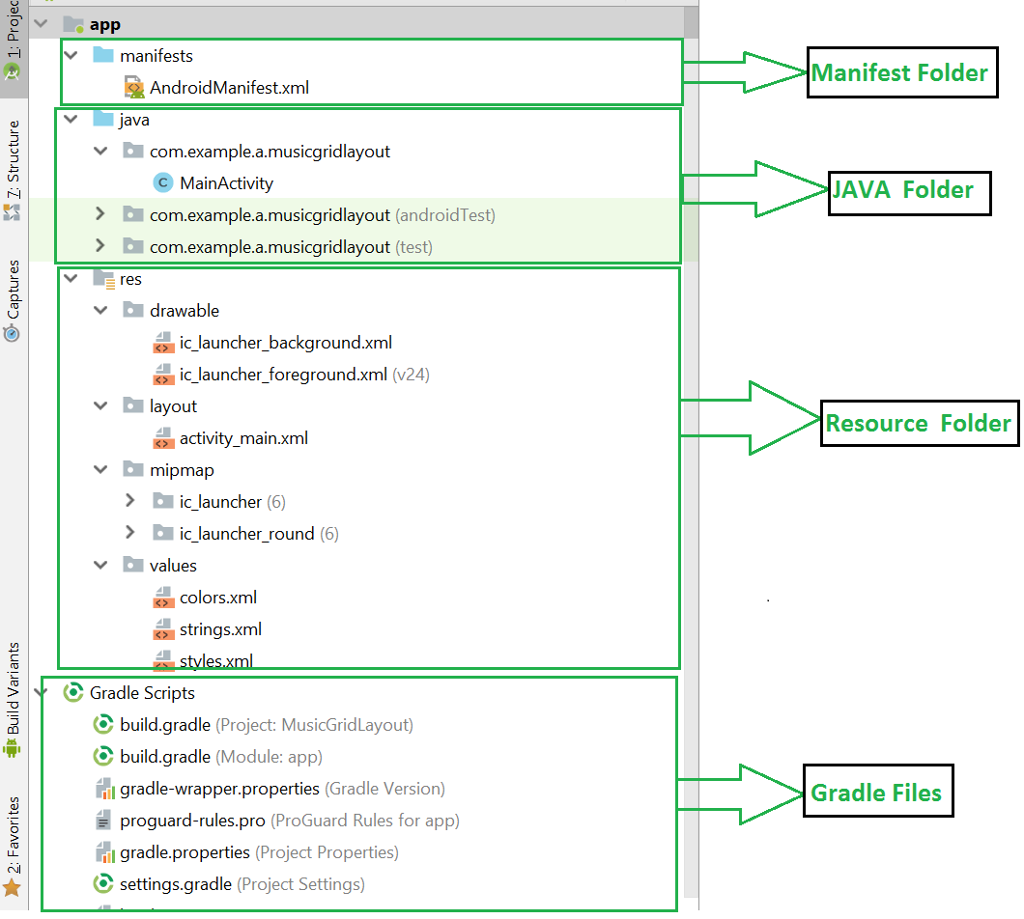
3. Structural Layout Of Android Studio

Slide 10
The above figure represents the various structure of an app.
Manifest Folder: Android Manifest is an XML file that is the root of the project source set. It describes the essential information about the app and the Android build tools, the Android Operating System, and Google Play. It contains the permission that an app might need in order to perform a specific task. It also contains the Hardware and the Software features of the app, which determines the compatibility of an app on the Play Store. It also includes special activities like services, broadcast receiver, content providers, package name, etc.
Java Folder: The JAVA folder consists of the java files that are required to perform the background task of the app. It consists of the functionality of the buttons, calculation, storing, variables, toast(small popup message), programming function, etc. The number of these files depends upon the type of activities created.

Slide 11
Resource Folder: The res or Resource folder consists of the various resources that are used in the app. This consists of sub-folders like drawable, layout, mipmap, raw, and values. The drawable consists of the images. The layout consists of the XML files that define the user interface layout. These are stored in res.layout and are accessed as R.layout class. The raw consists of the Resources files like audio files or music files, etc. These are accessed through R.raw.filename. values are used to store the hardcoded strings(considered safe to store string values) values, integers, and colors. It consists of various other directories like:
R.array :arrays.xml for resource arrays
R.integer : integers.xml for resource integers
R.bool : bools.xml for resource boolean
R.color :colors.xml for color values R.string : strings.xml for string values
R.dimen : dimens.xml for dimension values
R.style : styles.xml for styles

Slide 12
Gradle Files: Gradle is an advanced toolkit, which is used to manage the build process, that allows defining the flexible custom build configurations. Each build configuration can define its own set of code and resources while reusing the parts common to all versions of your app. The Android plugin for Gradle works with the build toolkit to provide processes and configurable settings that are specific to building and testing Android applications. Gradle and the Android plugin run independently of Android Studio. This means that you can build your Android apps from within Android Studio. The flexibility of the Android build system enables you to perform custom build configurations without modifying your app’s core source files.

Slide 13
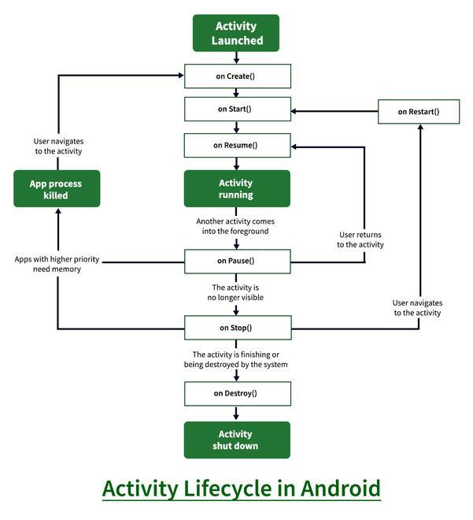
4. Lifecycle of Activity in Android App

Slide 14
States of Android Lifecycle:
OnCreate: This is called when activity is first created.
OnStart: This is called when the activity becomes visible to the user.
OnResume: This is called when the activity starts to interact with the user.
OnPause: This is called when activity is not visible to the user.
OnStop: This is called when activity is no longer visible.
OnRestart: This is called when activity is stopped, and restarted again.
OnDestroy: This is called when activity is to be closed or destroyed.

Slide 15
How to Publish Your Android App on Google Play Store?
Nowadays smartphones are among the most essential gadgets for users. Over 60% of people sleep with their phones by their side and check it first thing in the morning. Almost all businesses, including retail stores, have mobile apps to keep their audience engaged. Various applications like games, music player, camera, etc. are built for these smartphones for running on Android. Google Play store features quite 3.3 million apps.
Building a dream app that reflects your idea, but, what next? Building a mobile app simply means you’re half done. But one must concern about the launch of the application. It’s very confusing because as a beginner, they are not friendly with the google play store guidelines. So let’s understand step by step process to publish your android app on google play store.

Slide 16
Step 1: Make a Developer Account
Step 2: After you completed step 1 you will be redirected to this page where you have to click on the CREATE APPLICATION button.
Step 3: Store listing
Step 4: App release
Step 5: Content rating
Step 6: Pricing & distribution
Step 7: App content
Step 8: App releases

Slide 17
Create an Android project
This lesson shows you how to create a new Android project with Android Studio, and it describes some of the files in the project.
To create your new Android project, follow these steps:
Install the latest version of Android Studio.
In the Welcome to Android Studio window, click Create New Project.
If you have a project already opened, select File > New > New Project.
In the Select a Project Template window, select Empty Activity and click Next.
In the Configure your project window, complete the following:
Enter "My First App" in the Name field.
Enter "com.example.myfirstapp" in the Package name field.

Slide 18
If you'd like to place the project in a different folder, change its Save location.
Select either Java or Kotlin from the Language drop-down menu.
Select the lowest version of Android you want your app to support in the Minimum SDK field.
Note: The Help me choose link opens the Android Platform/API Version Distribution dialog. This dialog provides information about the various versions of Android that are distributed among devices. The key tradeoff to consider is the percentage of Android devices you want to support versus the amount of work to maintain your app on each of the different versions that those devices run on. For example, if you choose to make your app compatible with many different versions of Android, you increase the effort that's required to maintain compatibility between the oldest and newest versions.
If your app will require legacy library support, mark the Use legacy android.support libraries checkbox.
Leave the other options as they are.
Click Finish.
After some processing time, the Android Studio main window appears.

Slide 19
THANK YOU
For queries
Email: parveen.e13339@cumail.in

